Slide 1

Meetings in the Scrum Methodology
By: DevOpsDynasty

Slide 2

Motivation
86% of software development teams have adopted an Agile methodology
81% of Agile teams use some version of the Scrum methodology
If you were hired today as a Project Manager, you should know how to organize a team using the most common methodology
Alternatively, if you were hired as a Software Developer, you should understand how the most common methodology works
Sources:
https://www.parabol.co/resources/agile-statistics/#agile-adoption
https://digital.ai/resource-center/analyst-reports/state-of-agile-report/

Slide 3
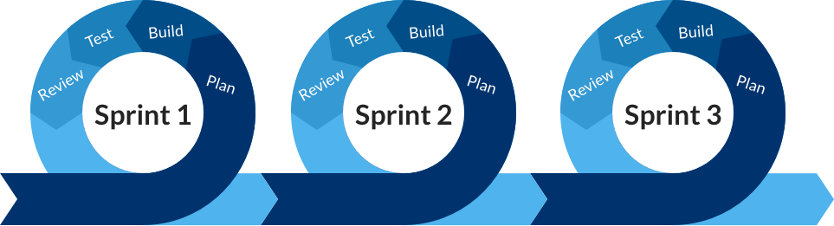
High Level Review of Agile/Scrum
Agile is an iterative project management methodology
Scrum is a type of Agile methodology that consists of fixed-length "sprints"

Slide 4
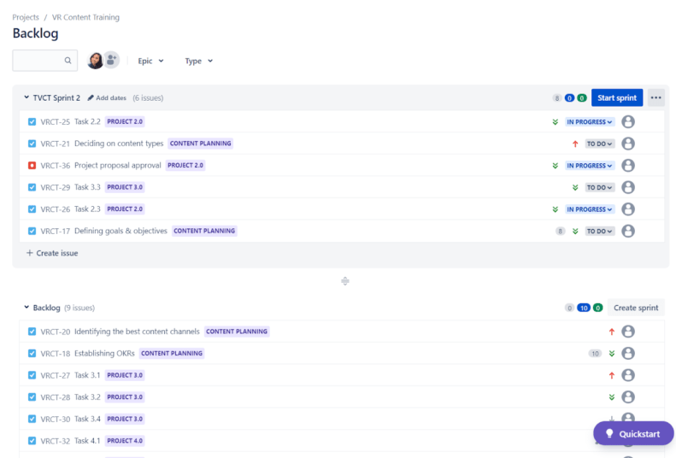
High Level Review of Agile/Scrum
Tasks in Scrum are written down and added to the Product/Project Backlog
This is a "To Do" list for the project
For each sprint, tasks to be completed in that sprint are added to its Sprint Backlog
This is a "To Do" list for the sprint

Slide 5

Daily Stand-Up
Brief overview:
Description
Focus: What I did yesterday, what I am doing today, any obstacles or impediments.
Purpose
Sharing ideas quickly
Finding the best solution
Keeping everyone updated
Creates accountability
Enhances teamwork

Slide 6
Daily Stand-up
"Kanban" is the Japanese word for "visual signal".
Use Kanban board to make meetings less painful
Help you visualize your work with the philosophy of continuous improvement.
Used by majority of the giants in the tech industry.

Slide 7
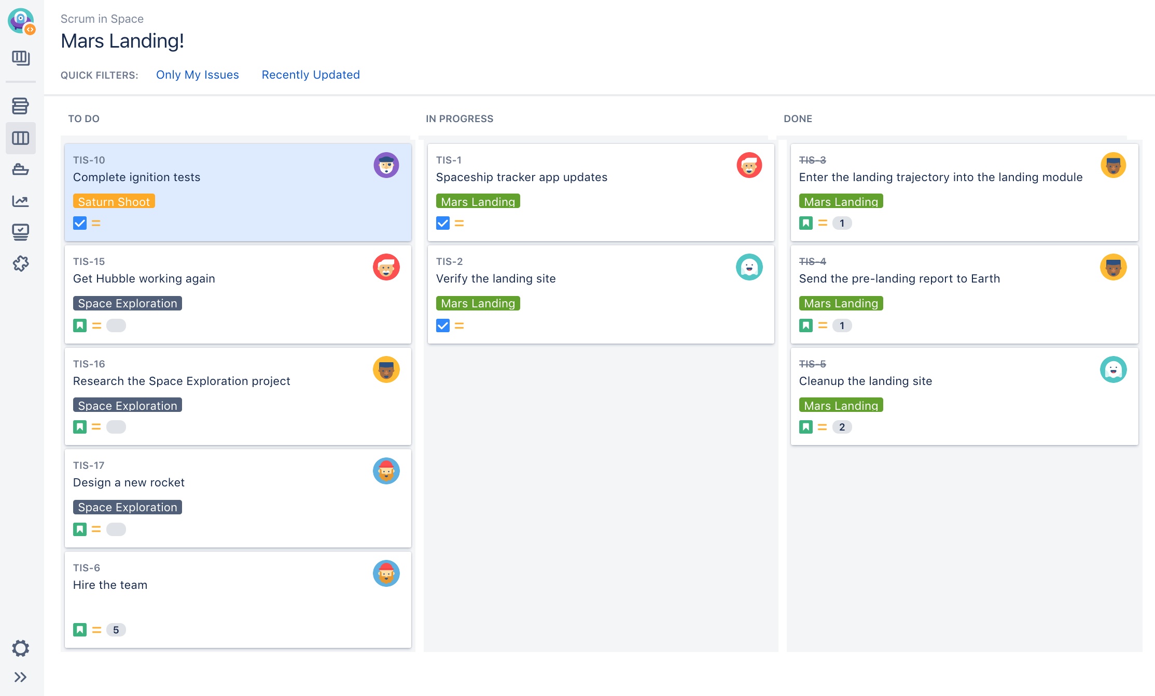
Daily Stand-Up

Slide 8
Daily Stand-Up
🍿🍿Brace yourselves for this video demonstration – because nothing says 'thrilling' like a Daily Stand-up meeting! 🍿🍿
KNOWLEDGE

Slide 9
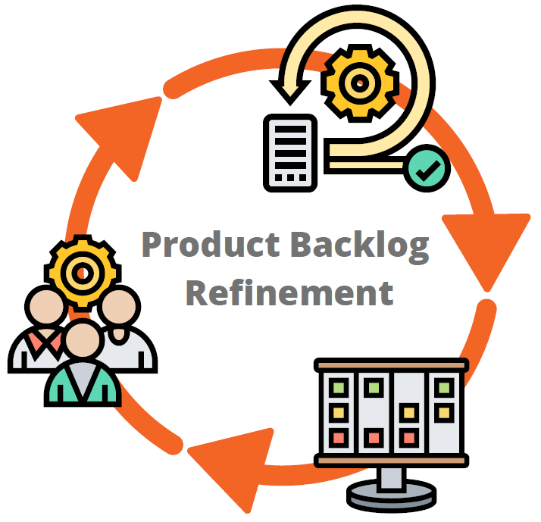
Backlog Refinement
Problem: Many people are constantly adding new tasks to the Project Backlog. We need to ensure tasks are ready to be started before being added to a Sprint Backlog.
Solution: Backlog Refinement!

Slide 10
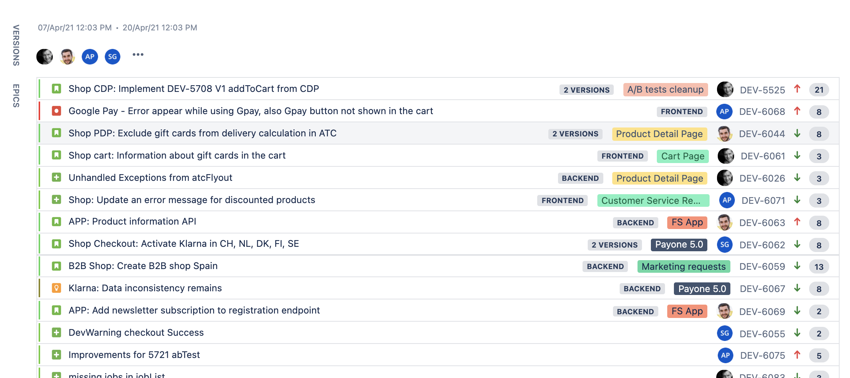
Backlog Refinement
Who:
Project Manager, Product Owner, Developers.
When:
As much as needed to maintain a refined Project Backlog.
What:
Tasks are checked for relevance and size
Tasks are assigned priorities
Additional details are added to tasks
Tasks are estimated
Bonus: Helps gives all team members a unified vision for the project

Slide 11

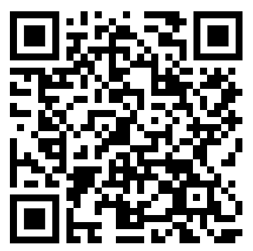
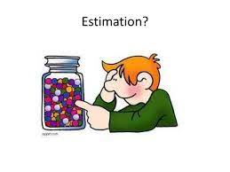
Backlog Refinement - Estimation
Let's go through an example task estimation together!
Scan this to visit the website where we will estimate the task.
Don't make an account, just enter a name.

Slide 12
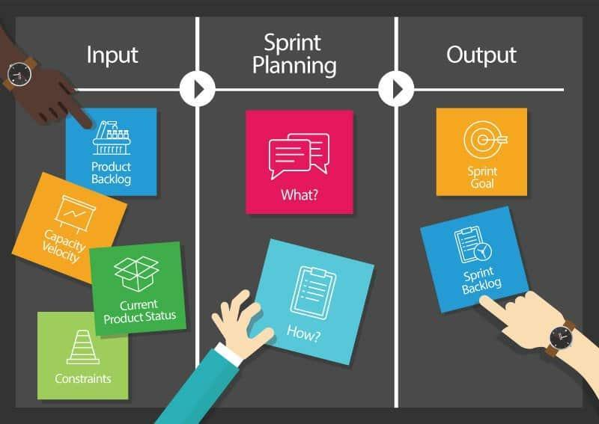
Sprint Planning
What?
How?
Notes:
Sprint Planning is a designated time where a team collaboratively map out the next phase of their journey. It's a dynamic session where you define the 'what' and 'how' of our upcoming sprint. You identify our goals, select tasks, estimate efforts, and ensure that everyone on the same page. Essentially, Sprint Planning is your roadmap to success, ensuring that each step you take is purposeful aligned with the project objectives.

Slide 13
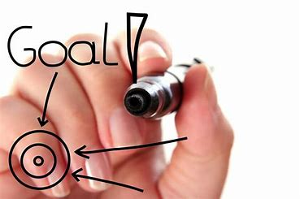
Sprint Planning
Goals:
Define the scope of work for the upcoming sprint
Set realistic and achievable sprint goals
Allocate resources effectively

Slide 14
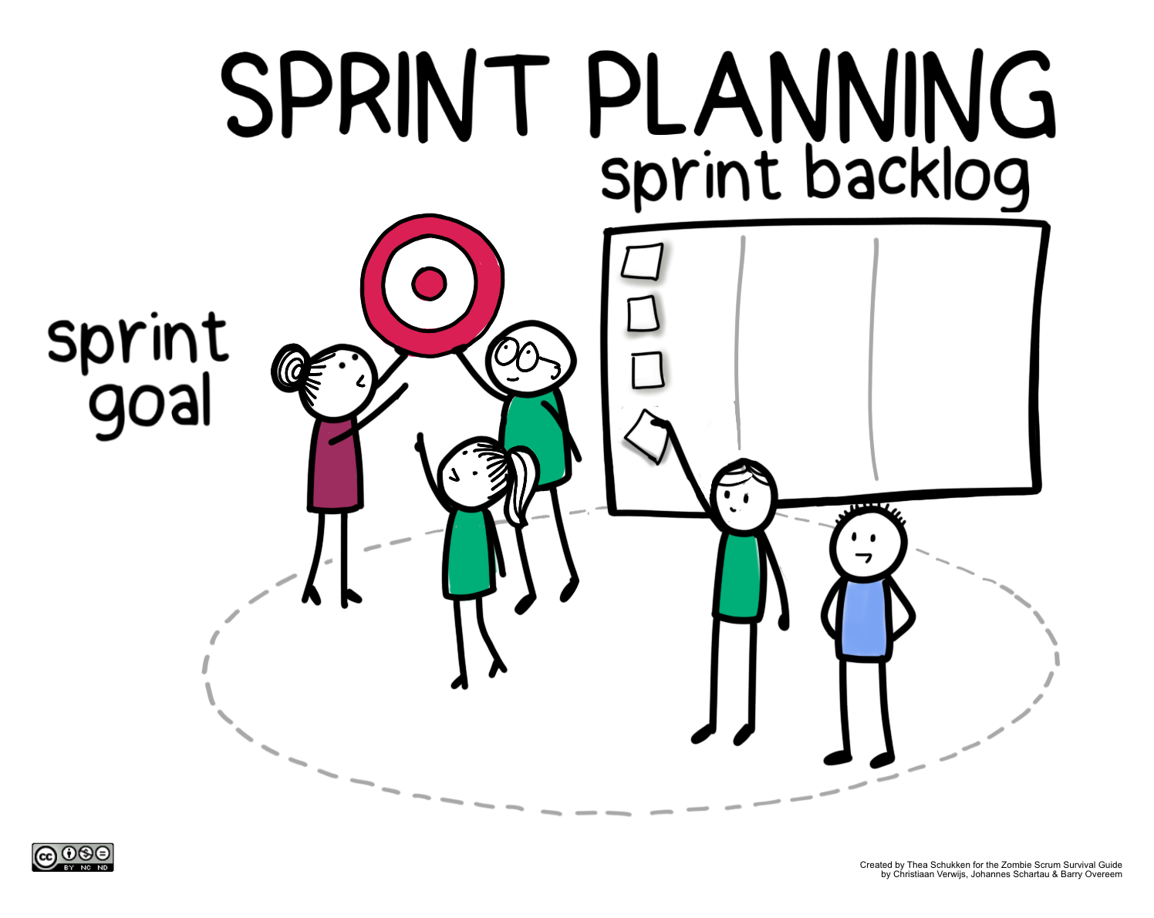
Sprint Planning: Agenda
Defining the sprint goal
Collaboratively selecting user stories or tasks
Estimating effort and capacity planning

Slide 15
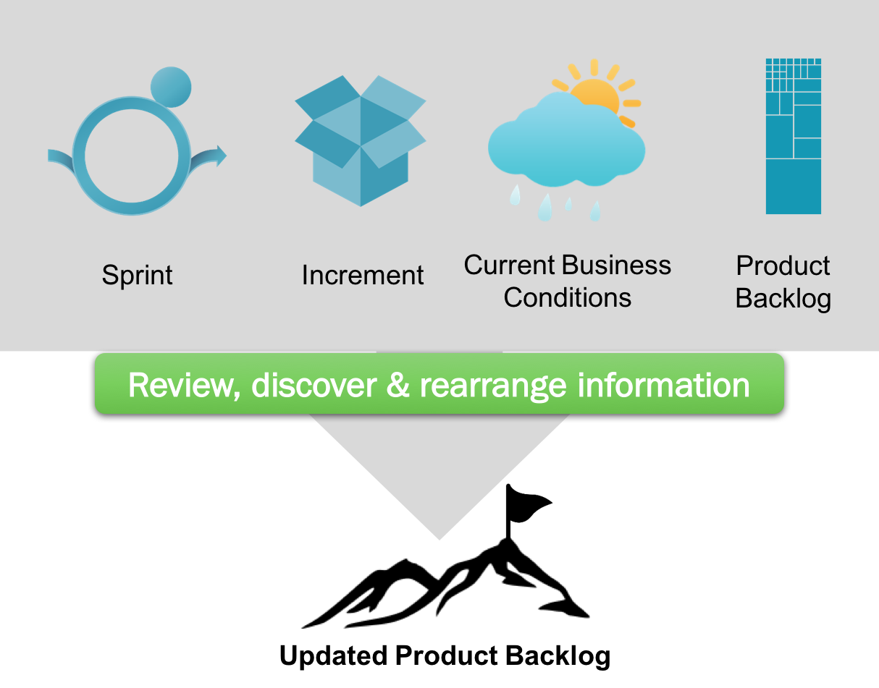
Sprint Review
At the end of every sprint, the team meets and discusses the last sprint

Slide 16

Sprint Review
The sprint review includes all stakeholders of the project
Focus is on the work completed and project progress during the sprint
The main goal of this review is to discover:
What went right during the last sprint (Celebrate victories)
What went wrong during the last sprint (What can be improved)
What was finished during the last sprint (And what needs to be pushed)

Slide 17

Sprint Review
Team will discuss what went right during the last sprint (As long as you have a supportive team!).
Some examples:
Effective communication
Staying on schedule
Staying under budget

Slide 18
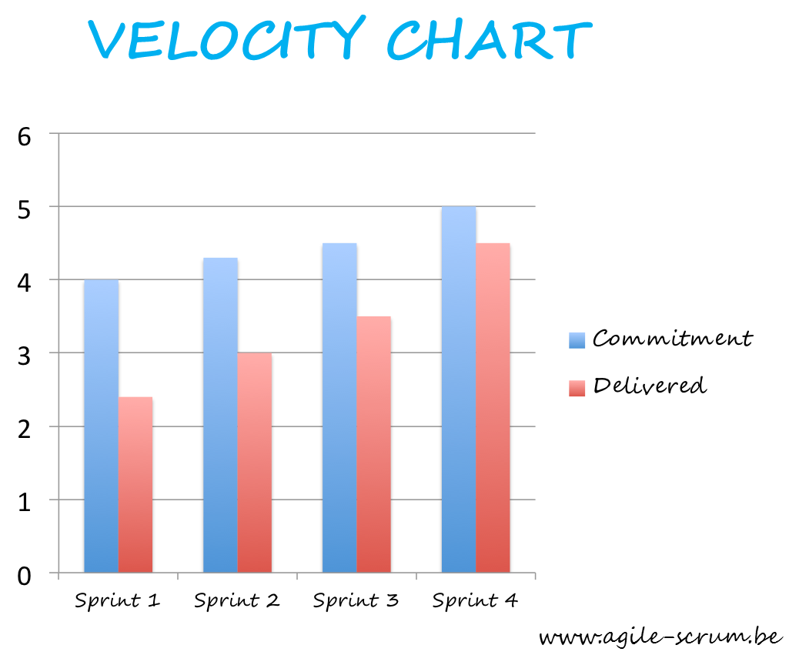
Sprint Review
Team will discuss what should be improved in the future. For example:
Better documentation
Keeping a consistent project velocity
Poor communication

Slide 19
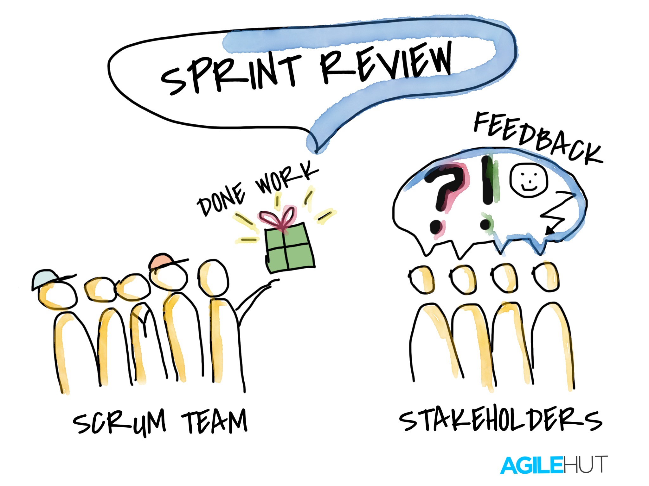
Sprint Review
The team will discuss what was finished during the last sprint
This may involve showing features to key stakeholders and getting their opinions.
Any unfinished tasks should be officially moved into the next sprint

Slide 20

Sprint Review
The team should feel confident moving forward
A plan should be made to include tasks from the project backlog in future sprints
The team should feel strong in their ability to fix any mistakes made in the past

Slide 21

Better Sprint Reviews
Try to discuss any changes, including changes in the market, stakeholder opinions, or customer feedback that may impact your project
Make sure all stakeholders are invited (getting a diverse opinion is important)
Be honest (but not rude!)
Gather as much feedback as possible

Slide 22
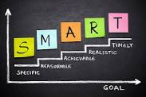
Better Sprint Reviews
Invite everybody to share their opinion (not just the project manager)
Create project velocity charts (so that estimation can get better over time)
Have clear goals for the future

Slide 23

Sprint Retrospective (Retro)
Purpose:
All the other meetings have focused on improving the product.
The sprint review focuses on the work completed and project progress from the last sprint.
In contrast, the sprint retrospective is the time to focus on the workflow and process.

Slide 24



Sprint Retrospective
Who?
When?
What?
Project Manager and Developers.​
Keeping this meeting small and internal to the team makes everyone more comfortable voicing their opinions.
At the end of every sprint.
Celebrate successes, address failures, brainstorm and discuss questions.
Identify areas for improvement in the process and create a plan to implement changes.

Slide 25
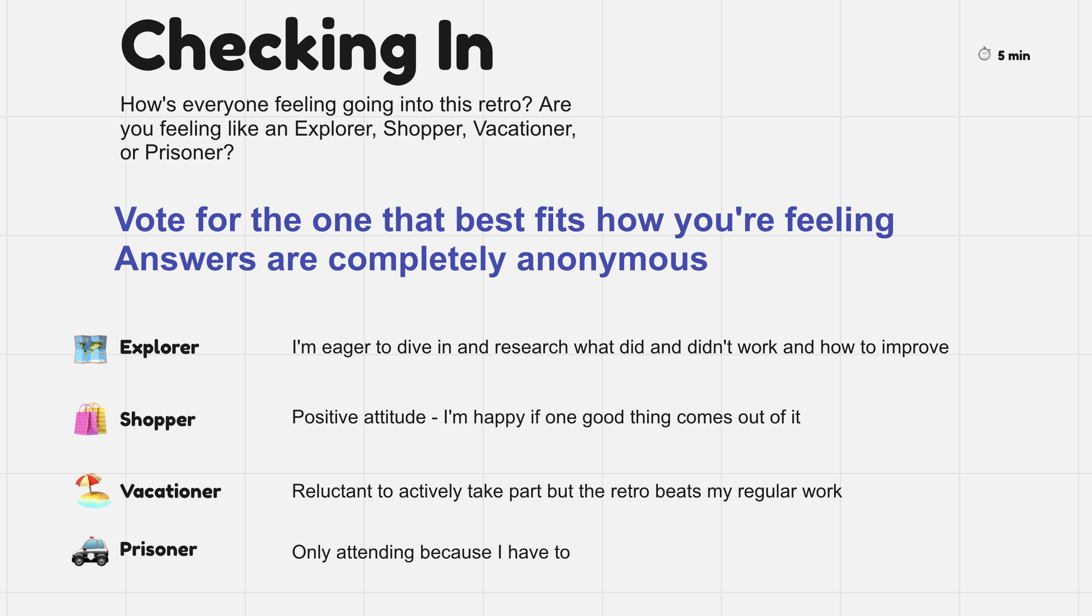
Sprint Retrospective - Real World Example

Slide 26
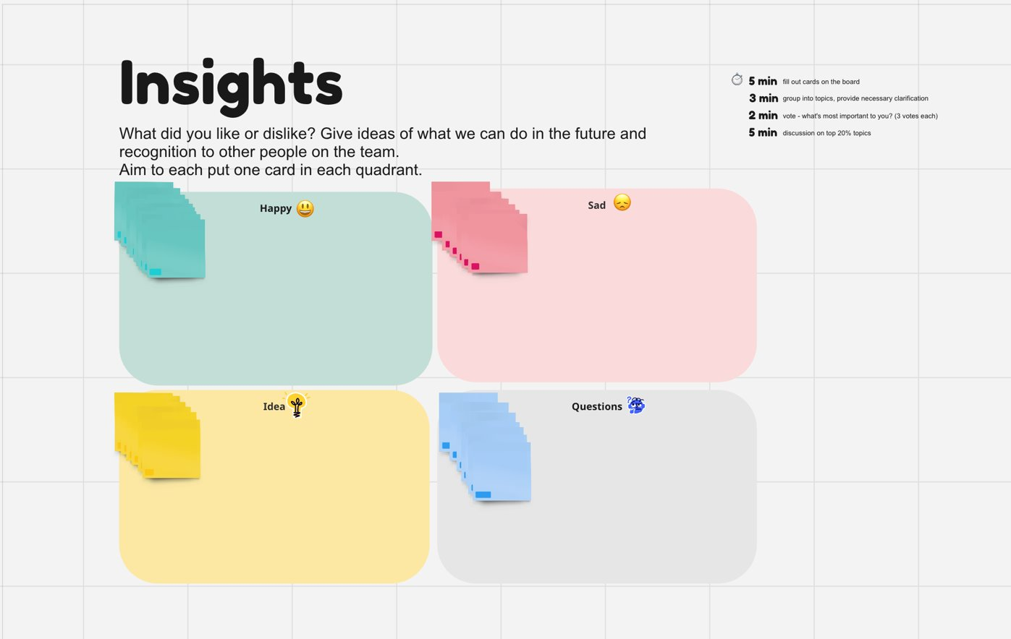
Sprint Retrospective - Real World Example

Slide 27
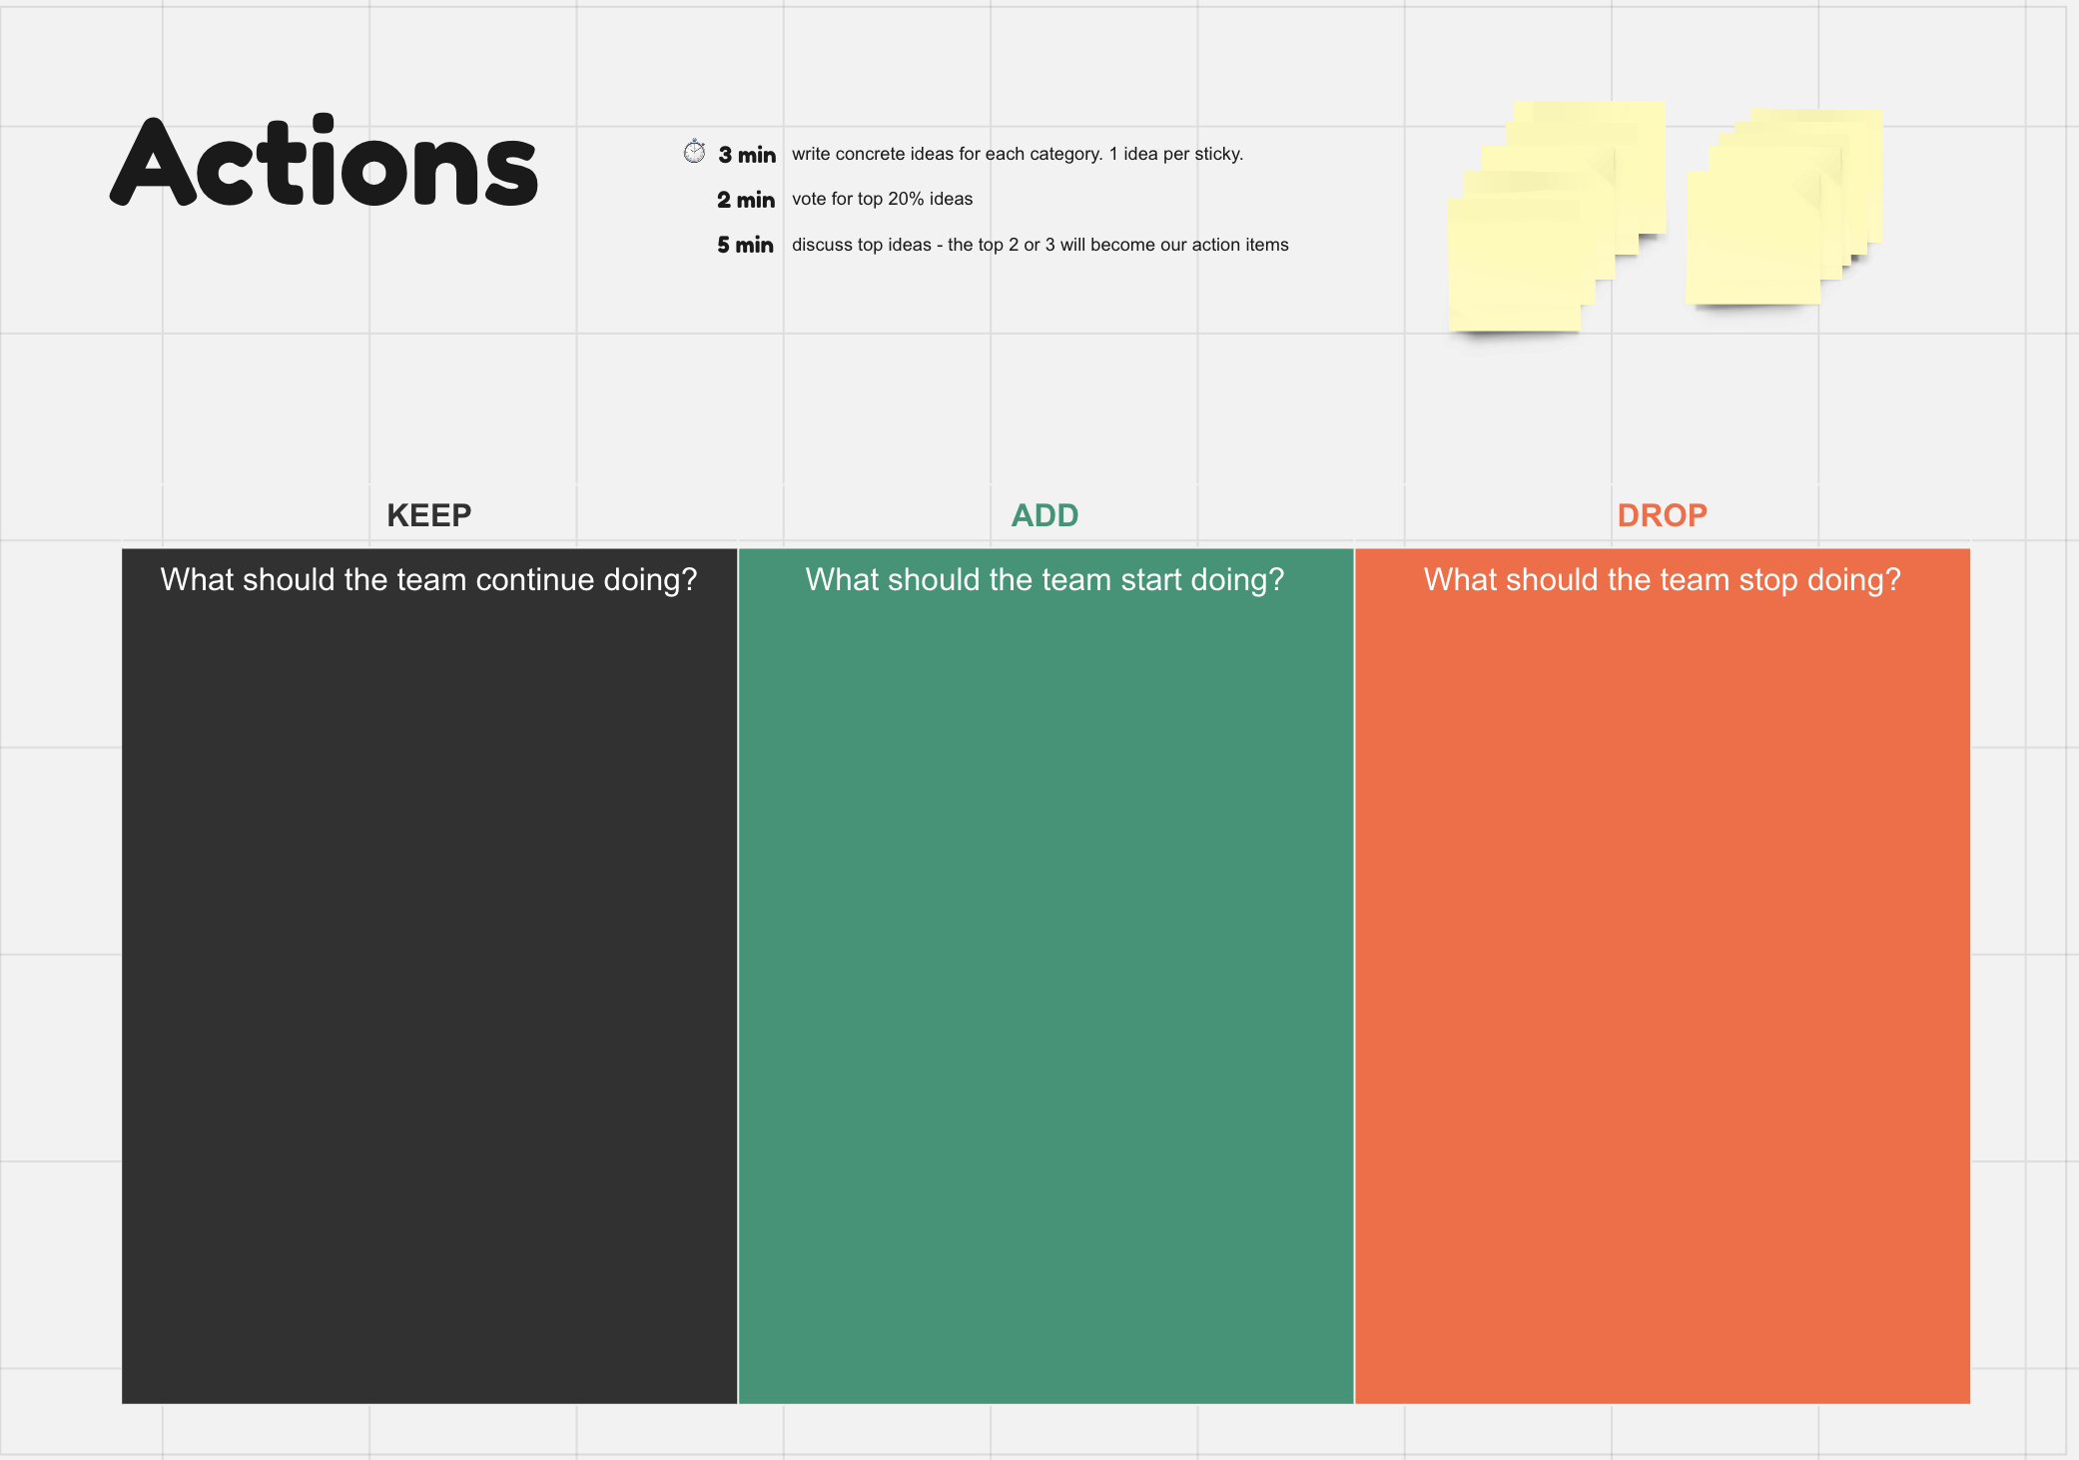
Sprint Retrospective - Real World Example

Slide 28
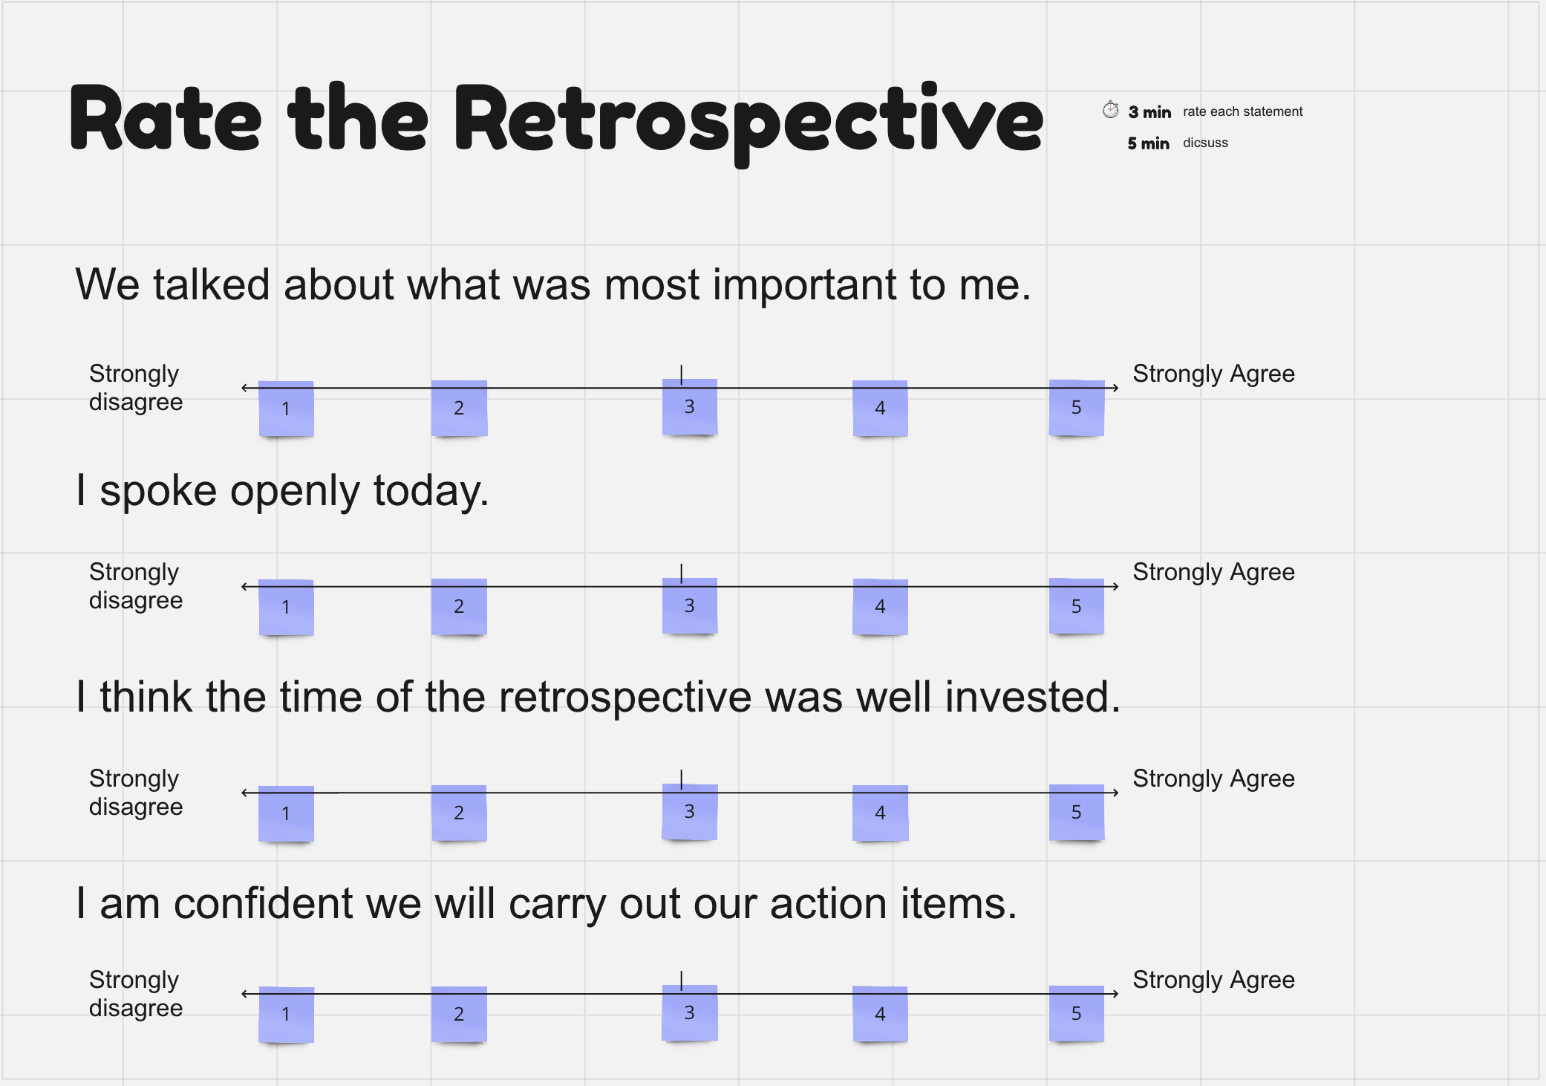
Sprint Retrospective - Real World Example

Slide 29

Q&A + Candy Canes!

Slide 30
References
[1] H. Peck, “Agile Meetings: What Are They & How to Manage Them,” ClickUp, Jun. 24, 2022. https://clickup.com/blog/agile-meetings/#0-what-are-agile-meetings-
[2] D. Radigan, “Four Agile Ceremonies, Demystified,” Atlassian, 2019. https://www.atlassian.com/agile/scrum/ceremonies
[3] J. MacKay, “Master the 5 Agile Ceremonies,” Planio, Jul. 05, 2022. https://plan.io/blog/agile-ceremonies-guide/#5-product-backlog-refinement
[4] M. Rehkopf, “Backlog Refinement Guide: How to & Tips to be Successful,” Atlassian, 2023. https://www.atlassian.com/agile/scrum/backlog-refinement
[5] S. Laoyan, “Sprint Backlog backed-up? Try Backlog Refinement,” Asana, Oct. 29, 2022. https://asana.com/resources/backlog-refinement
[6] C. MacNeil, “How to Run an Effective Sprint Retrospective Meeting,” Asana, Oct. 13, 2022. https://asana.com/resources/sprint-retrospective

